Slide 1
Unit 1 Introduction to Digital Image Processing
Total Hour:4Hrs
Presented by
Er.Harendra Bikram Shah (Lecturer)
Department of Computer Engineering
NAST

Slide 2
OUTLINES
Unit 1: Introduction to Digital Image Processing [4 hrs]
1.1 Fundamental Steps and Elements of DIP
1.2 Applications Areas of DIP
1.3 Elements of Visual Perception, Sampling and Quantization
1.4 Image and its types (Color Image, grayscale Image)
1.5 Relationship between Pixels (Neighbours, Path, Connectivity, Adjacency, Distances).

Slide 3
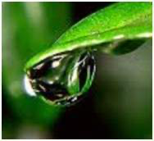
Introduction to Image and Its Processing
The Pictorial representation of an object is image.
An image is nothing more than a two-dimensional signal.
Pixel is the smallest element of an image.
In an 8-bit gray scale image, the value of the pixel between 0 and 255.
The value of f(x,y) at any point gives the pixel value at that point of an image.

Slide 4
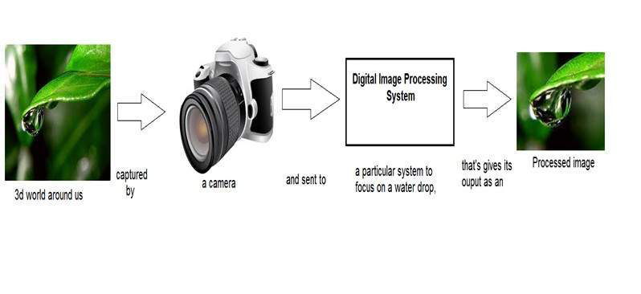
Introduction to Image and Its Processing
A digital image is a representation of a real image as a set of numbers that can be stored and handled by a digital computer.
DIP refers processing the digital image by the use of digital computer on the basis of digitization (Sampling and quantization)
Digital image processing is the use of computer algorithms to perform image processing on digital images.

Slide 5
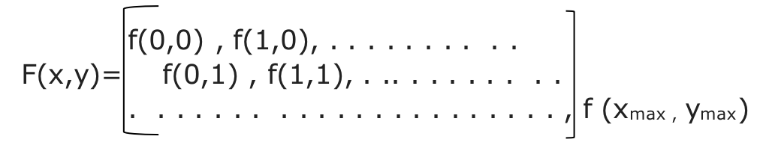
Introduction to Image and Its Processing
A digital image is an image f(x, y) that has been discretized both in spatial co-ordinates and in brightness.
It is represented by 2D integer array.
The digitized brightness values is called gray level values.
Digital image can be represented as a matrix as shown below:

Slide 6
Origin of Digital Image
Decade | Key Event | Significance
1920s | Bartlane cable picture transmission system | First commercial application of digital image processing.
1960s | Development of digital image processing techniques at research institutions | Foundation of the field, with applications in satellite imagery, medical imaging, and character recognition.
1970s | Invention of CT scans | Revolutionized medical imaging.
1970s | Emergence of digital photography(Invention of Digital Camera) | Laid the groundwork for the widespread use of digital images.
1980s | Advancements in computer hardware and software | Increased processing power and storage capacity, making digital image processing more accessible.
1990s | Introduction of the JPEG image format | Enabled efficient compression and transmission of digital images.
2000s | Explosion of digital photography and video | Maximum use of digital cameras and smartphones
2010s and beyond | Advances in artificial intelligence and machine learning | Enabled powerful image processing algorithms for tasks like image recognition and object detection.

Slide 7
Application Areas/Examples of Fields that Use Digital Image Processing
Field Applications
Medical Imaging X-rays, CT scans, MRI, ultrasound
Computer Vision Facial recognition, object detection, autonomous vehicles
Remote Sensing Satellite imagery, aerial photography
Entertainment Digital photography, video editing, special effects
Law Enforcement Forensic analysis, surveillance
Robotics Computer vision for navigation and interaction
Astronomy Image processing of celestial objects
Agriculture Crop health monitoring, yield estimation
Manufacturing Quality control, inspection
Art Digital art, animations
Education Teaching and learning about visual information

Slide 8
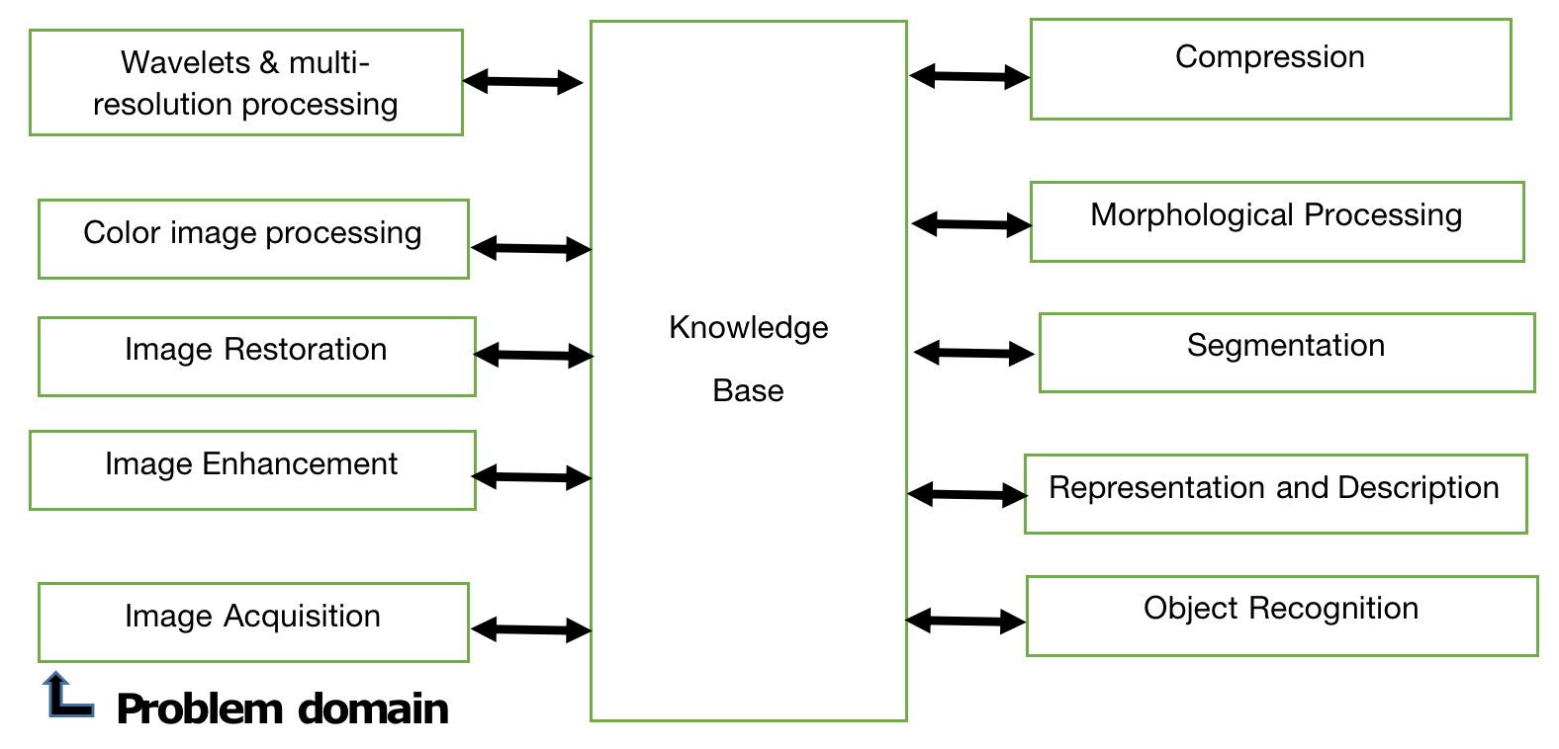
Fundamental Steps in Image Processing Systems

Slide 9
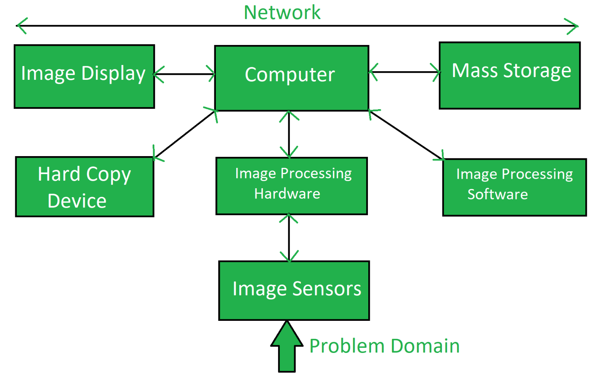
Elements of Digital Image Processing Systems

Slide 10
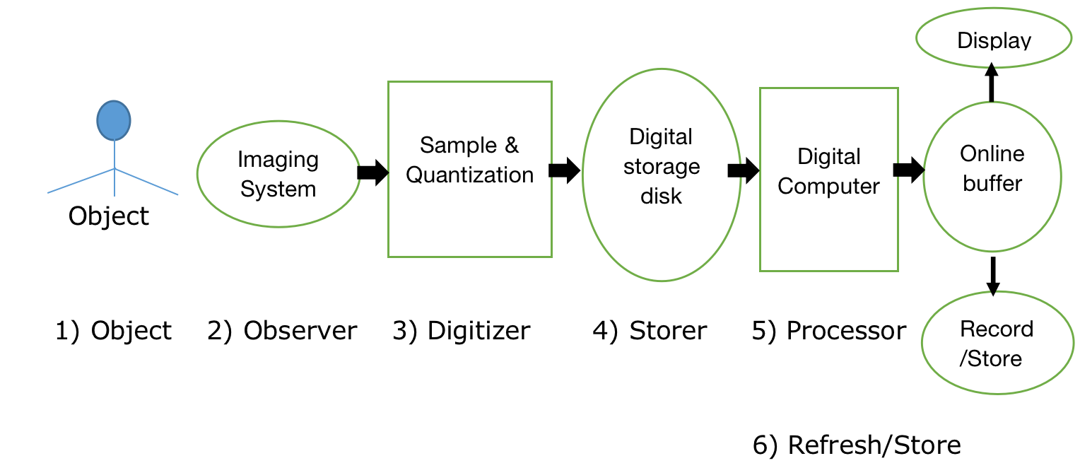
A typical Image Processing Sequence:

Slide 11
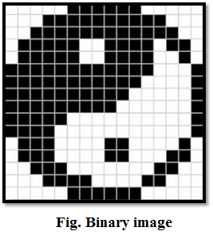
Types of Images
1. Binary Images
It is the simplest type of image.
It takes only two values i.e., Black and White or 0 and 1.
The binary image consists of a 1-bit image and it takes only 1 binary digit to represent a pixel.
Binary images are mostly used for general shape or outline.

Slide 12
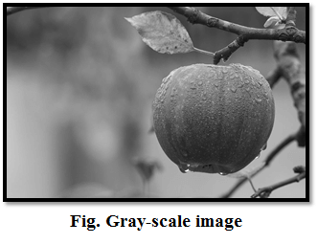
Types of Images
2. Gray-scale images
Grayscale images are monochrome images, Means they have only one color.
Grayscale images do not contain any information about color.
Each pixel determines available different grey levels.
A normal grayscale image contains 8 bits/pixel data, which has 256 different grey levels.
In medical images and astronomy, 12 or 16 bits/pixel images are used.

Slide 13
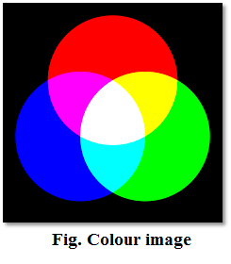
Types of Images
3. Colour images
Three band monochrome images in which, each band contains a different color and the actual information is stored.
The color images contain gray level information in each spectral band.
The images are represented as red, green and blue (RGB images).
And each color image has 24 bits/pixel means 8 bits for each of the three color band(RGB).

Slide 14
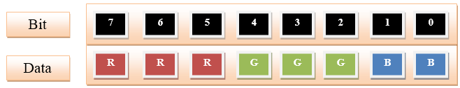
Types of Images
8-bit color format
8-bit color is used for storing image information in a computer's memory or in a file of an image.
In this format, each pixel represents one 8 bit byte.
It has 0-255 range of colors, in which 0 is used for black, 255 for white and 127 for gray color.
The 8-bit color format is also known as a grayscale image. Initially, it was used by the UNIX operating system.

Slide 15
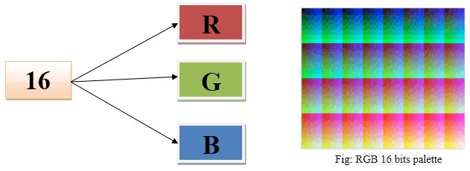
Types of Images
16-bit color format
The 16-bit color format is also known as high color format. It has 65,536 different color shades.
It is used in the system developed by Microsoft.
The 16-bit color format is further divided into three formats which are Red, Green, and Blue also known as RGB format.
In RGB format, there are 5 bits for R, 6 bits for G, and 5 bits for B.
One additional bit is added in green because in all the 3 colors green color is soothing to eyes.

Slide 16
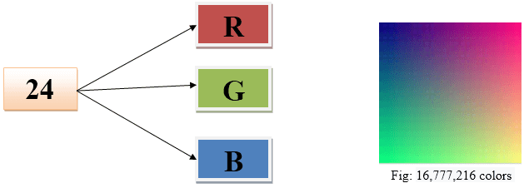
Types of Images
24-bit color format
The 24-bit color format is also known as the true color format.
The 24-bit color format is also distributed in Red, Green, and Blue.
As 24 can be equally divided on 8, so it is distributed equally between 3 different colors like 8 bits for R, 8 bits for G and 8 bits for B.

Slide 17
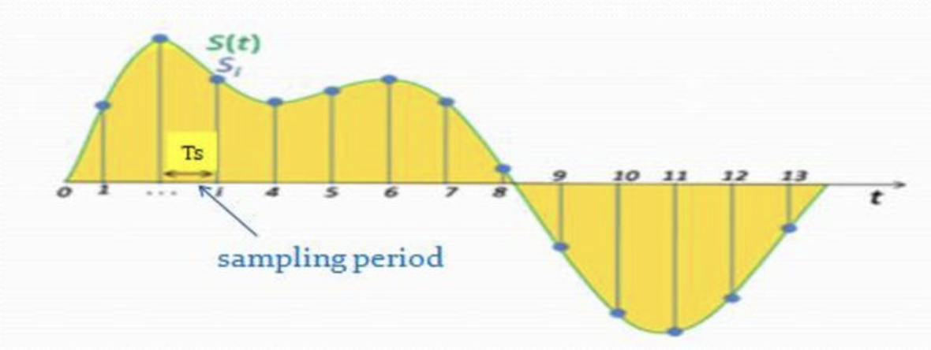
Image Sampling
It is the process where measurements are taken at regular space intervals.
Digitizing the spatial co-ordinates values (x, y) is called sampling.

Slide 18
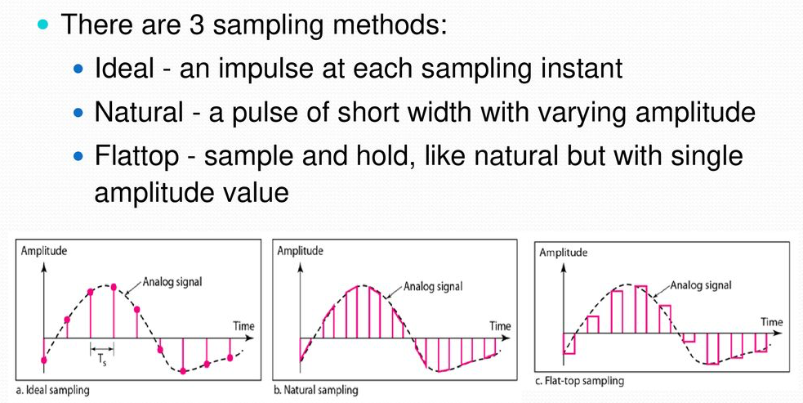
Image Sampling

Slide 19
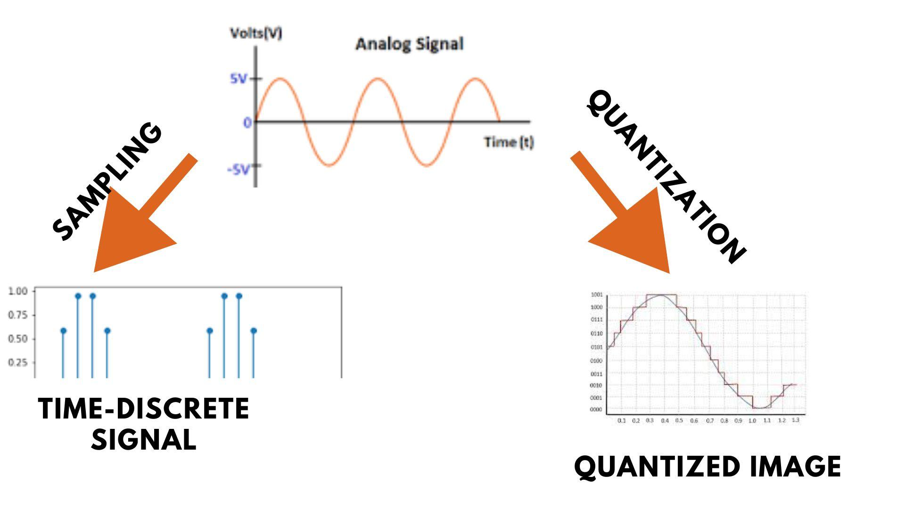
Image Quantization
Digitizing the amplitude values is called quantization.

Slide 20
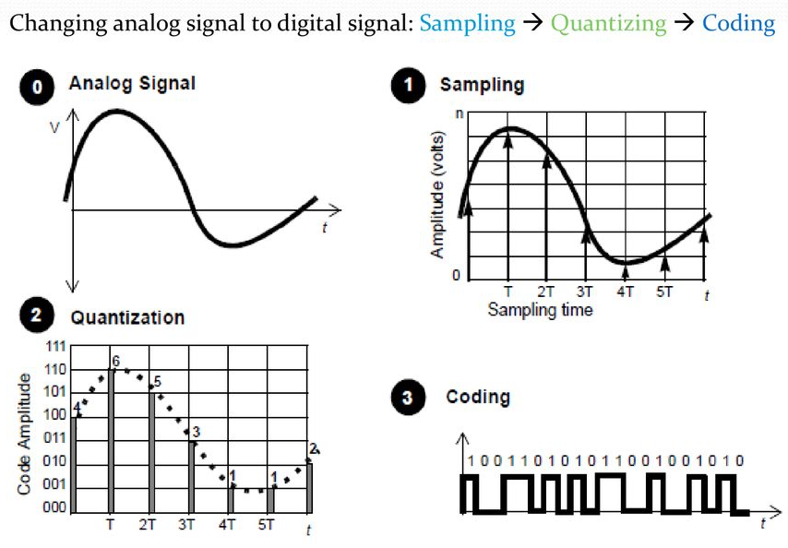
Image Sampling and Quantization

Slide 21
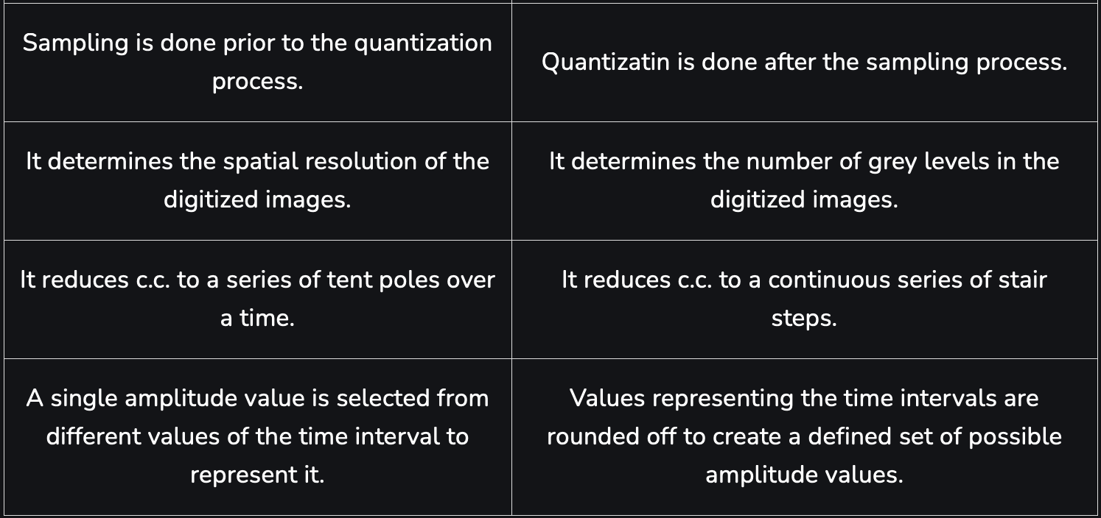
Image Sampling and Quantization

Slide 22
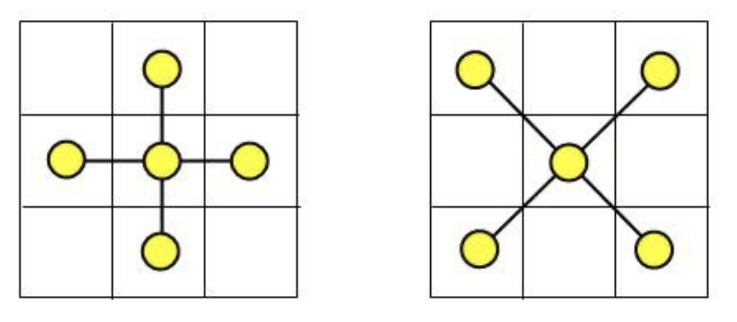
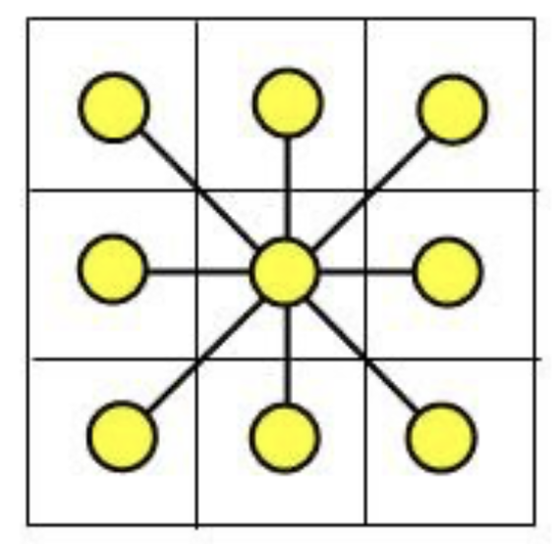
Some Basic relationship like Neighbor’s, Connectivity, Distance Measures between Pixels
Neighboring Relationships
4-connectivity: A pixel is connected to its four immediate neighbors: up, down, left, and right.
8-connectivity: A pixel is connected to its eight neighbors, including the diagonal ones.
4 Neighbourhood Pixels
8 Neighbourhood Pixels

Slide 23
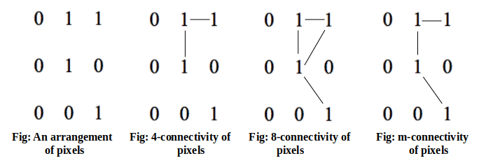
Connectivity
They are:
a) 4-connectivity: Two or more pixels are said to be 4-connected if they are 4-adjacent with each other’s.
b) 8-connectivity: Two or more pixels are said to be 8-connected if they are 8-adjacent with each other’s.
c) m-connectivity: Two or more pixels are said to be m-connected if they are m-adjacent with each other’s.

Slide 24



Distance Measures between Pixels
Euclidean Distance:
For two pixels at coordinates (x1, y1) and (x2, y2), the Euclidean distance d is given by:
Manhattan Distance (or City Block Distance):
For two pixels at (x1, y1) and (x2, y2), the Manhattan distance d is:
Chebyshev Distance:
For two pixels at (x1, y1) and (x2, y2), the Chebyshev distance d is:

Slide 25
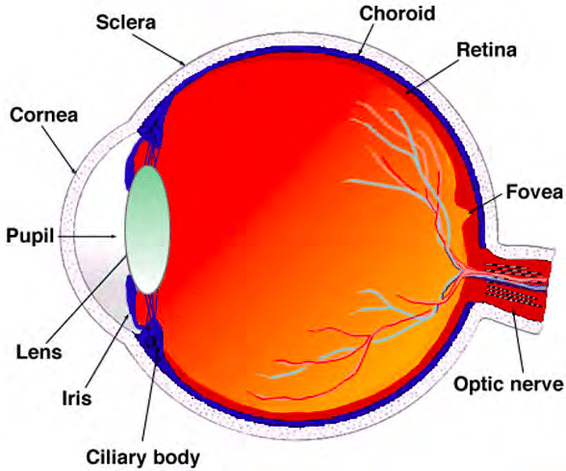
Elements of Visual Perception

Slide 26
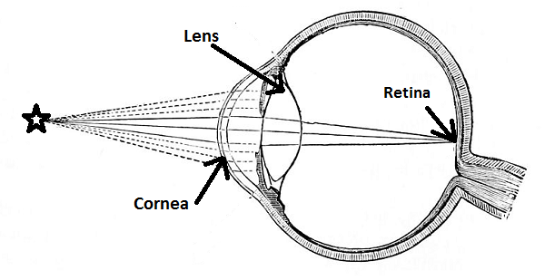
Elements of Visual Perception

Slide 27
Practice Question
A human eye which has in an average the diameter is from 14mm to 17mm which is nearly spherical in shape.
The lens of an eye is flexible than other ordinary optical lens.
Suppose the observer is looking at a tree which has 15m height at distance 100m.
Find the height of the retrieval image in an eye??
15m
17mm
100m
h=?

Slide 28
End of The Unit

Slide 29
THANK YOU

